Slide 1
Host Your Own Leadership Fair Presented by National Project Team Team Chair – Melanie Akey – Brentwood, CA Co-Chair – Angelica Reyes - Reno, NV

Slide 2
SPEAKERS Presented By: Rian Haag – Reno, NV Fiona Theseira– San Diego, CA

Slide 3
SPEAKERS
“REALTOR® ORGANIZATIONS”
National Women’s Council of Realtors® – (change yearly)
President, Line Officers, Executive Committee
State Women’s Council of Realtors® (change yearly)
President and Line Officers
National Association of Realtors®
President, Leadership Academy, RPAC
State Association of Realtors®
Local Association of Realtors®

Slide 4
SPEAKERS
“CITY / STATE / LOCAL”
STATE – Treasurer, Board of Equalization and Assembly
Candidate, Current or Prior
CITY
Mayor, Council, Planning
LOCAL
Chamber of Commerce, Builder’s Association
CHARITY / NON-PROFIT’S

Slide 5
SPEAKERS
“WEBSITE REFERENCE”
National Speakers Bureau
https://www.nationalspeakers.com/
National Speakers Association
https://www.nsaglac.org/find-a-speaker/speaker-search/
Women’s Council of Realtors®
National – http://www.wcr.org/
State - http://www.wcr.org/leadership.aspx
Charity / Non-Profit’s
https://topnonprofits.com/lists/best-nonprofits-on-the-web/
National Association of Realtors® Leadership
https://www.nar.realtor/national-leadership
State and Local Leadership Directory
https://www.nar.realtor/leadership.nsf

Slide 6
MARKETING Presented By: Fiona Theseira– San Diego, CA Angelica Reyes - Reno, NV Prepared By: Kathy Wade Turner – College Station, TX Katie McCartney – Columbus, OH

Slide 7
MARKETING
“CHECKLIST”
Create an eye catching flyer i.e., Facebook post, email, Instagram, etc.
Post Event & Create a Place to Invite: Facebook, Eventbrite, MailChimp etc.
(ask Strategic Partners to help and push in their database)
Speakers make 30 second video to post
Post of Speakers/Bio’s attending
Strategic Partners, Local Association, Speakers etc. to promote event
Text Message / Calls to Members (Invite Strategic Partners to help)
Create #hashtags:
#womenscouncilleadershipfair
#womenscouncil (state name)
#womenscouncil (local network name)

Slide 8
MARKETING
Sylvia Seabolt – 2019 Treasurer
Garland, TX

Slide 9
MARKETING
“TIMELINE”
90 Days Before: Select Venue, Room Setup, Speaker Setup, and Sponsorship
60 Days Before: Email Flyer to Database (Constant Contact, Mailchimp etc.)
(ask Strategic Partners to help and push in their database)
45 Days Before: Create Facebook Event, Invites & Post (Release Video 1)
30 Days Before: Confirm logistics with Speakers (Release Video 2)
15 Days Before: Facebook Post (ask Strategic Partners to share)
1 Week Before: FINAL marketing push – emails, social media (FINAL Video)

Slide 10
MATERIALS Presented By: Rian Haag – Reno, NV Angelica Reyes – Reno, NV

Slide 11
MATERIALS
“SUGGESTED PRINT ITEMS”
National Women’s Council of Realtors® –
Leadership Identification and Development Application
State and Local Association of Realtors® Applications
National Association of Realtors® Leadership Application
Chamber of Commerce Information
City / State / Local Information
Tent Cards (each table) i.e., NAR, State, Local etc.
Flyers, Programs, Website References

Slide 12
MATERIALS
“WEBSITE REFERENCE”
State and Local Leadership by Association (NAR List)
https://www.nar.realtor/leadership.nsf
National Speakers Bureau
https://www.nationalspeakers.com/
Women’s Council of Realtors® Project Team Materials
http://www.wcr.org/events/national-conference/
Women’s Council of Realtors® Leadership
http://www.wcr.org/network-tools/leadership-development-training/
National Association of Realtors® Application
https://www.nar.realtor/about-nar/leadership-and-staff/leadership-academy/application-instructions

Slide 13
LOGISTICS Presented By: Stacey Krolak – Scottsdale, AZ Linda Arvanitis – Ocala, FL

Slide 14
LOGISTICS
“Venue Selection (Selecting The Right Space)”
LOCATION LOCATION LOCATION!!!!!!
i.e., FREE, strategic sponsor location, local city/county
offices, share workspace (Co Hoots, Office Bowl)
Space Size: Small, Medium, Large
Breakout Session Space
Accessibility – drive time, parking, convenience

Slide 15
LOGISTICS
“SETUP AND MUST HAVES”
American Flag, AV Equipment, Podium or Dais on stage
(be sure attendees able to see speaker from anywhere in the room)
Room Setup (Speakers) –
Round table (more intimate), On Stage Panel, Rotation of Speakers
Determine Event Length - (Lunch or refreshments provided)
Strategic Sponsorship for event?
Agenda Timeline – helps keep speakers on track and event
Booth Interaction for Speakers After Event

Slide 16
LOGISTICS
“CHECKLIST”
Price of Event – Free, Member Pricing, Future Member Pricing
Registration table, sign-in sheets, name tags
Handout, PowerPoint Presentation or Both?
Speaker Bio, Headshot and Link to Website/Blog
Interactive Speaker Discussion (Q & A) – How much time?
Volunteers – Members, Strategic Partners? How Many?
Time Keepers For Speakers
Recorded Event and/or Facebook Live
Make It Upbeat – play music in between speakers
RELAX and ENJOY

Slide 17
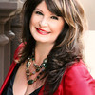
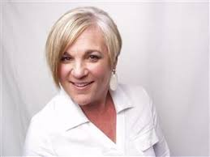
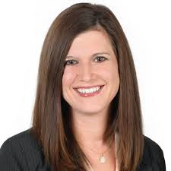
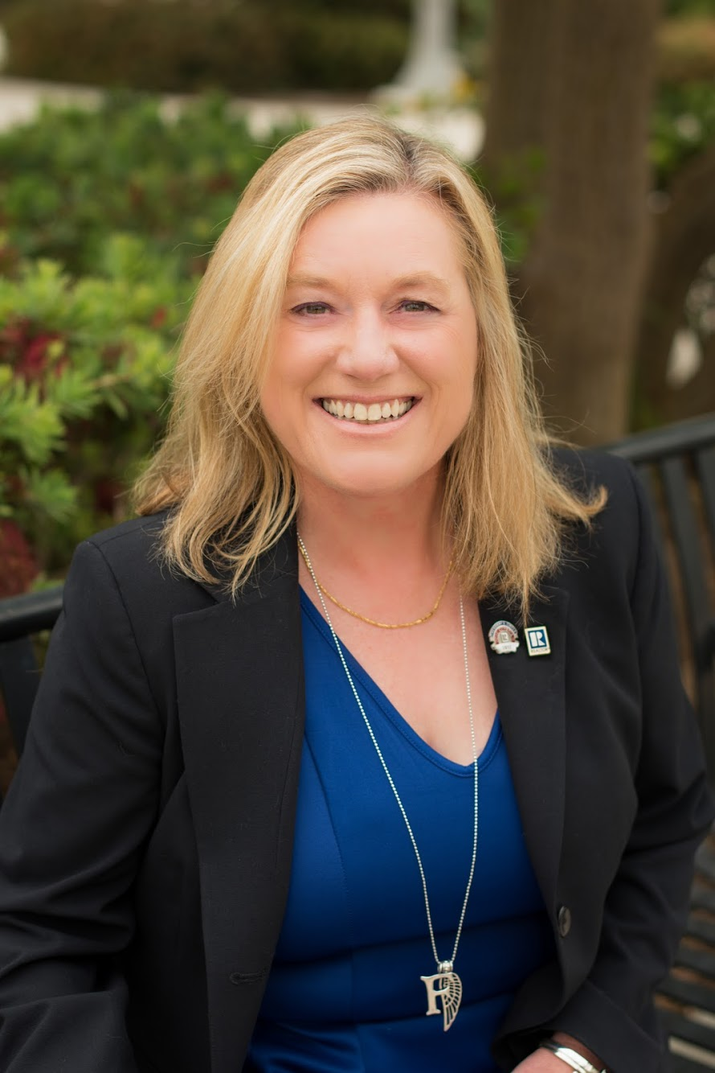
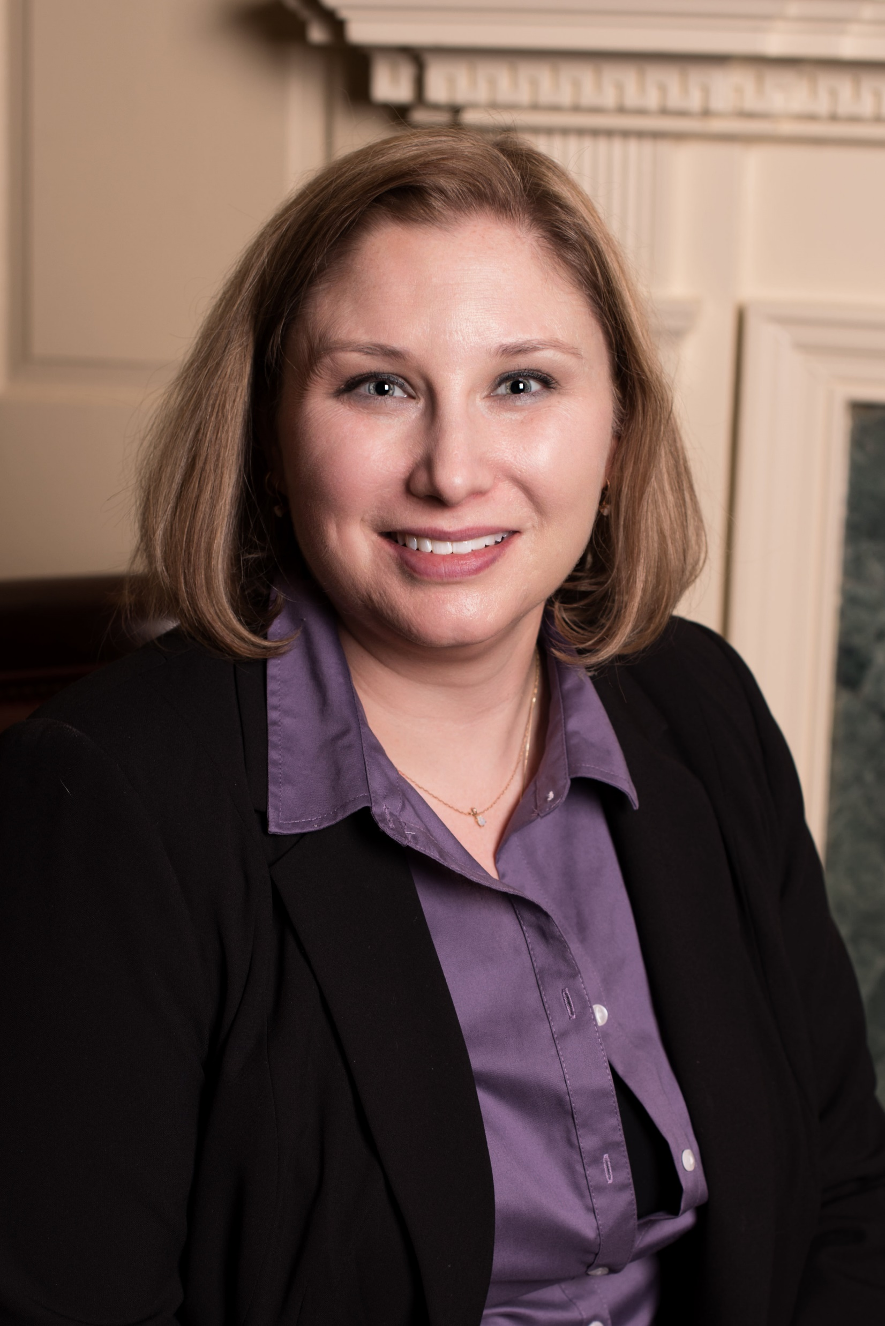
PROJECT TEAM
Melanie Akey
Angelica Reyes
Stacey Krolak
Rian Haag
Linda Arvanitis
Amy Menrad
Kathy Wade Turner
Fiona Theseira
Katie McCartney

Slide 18
To access Leadership Fair Materials visit:
http://www.wcr.org/events/national-conference/
Thank you!

