Slide 1
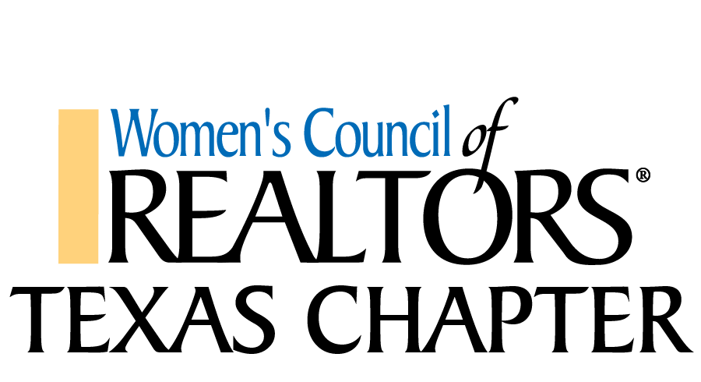

Slide 2
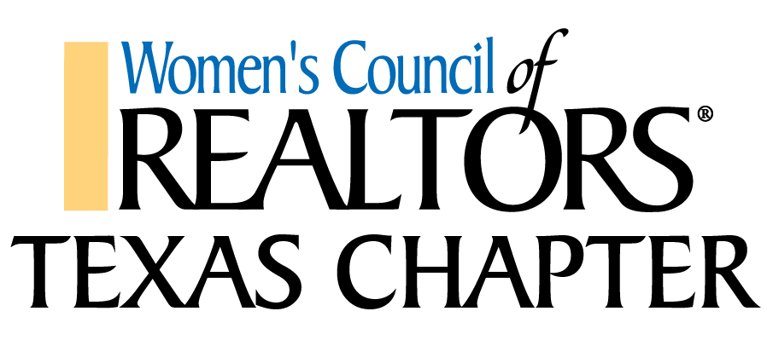
25-Chapters Across the State
Abilene El Paso del Norte Hill Country
Austin Fort Bend County Houston
Bay Area Houston Golden Triangle Lake Houston
Brazos Valley Great Northwest McAllen
Cameron County Greater Tarrant County Montgomery Country
Central Texas Greater West Houston San Antonio
Collin County Heart of Texas Southwest Dallas County
Dallas Highland Lakes Tyler
Dallas Metro East Hill Country

Slide 3
We have approximately 1600 Members which includes REALTORS®, National Affiliates and Local Affiliates.
National and Local Affiliate members consist of Mortgage Lenders, Real Estate Inspectors, Real Estate Appraisers, Real Estate Investors, Insurance Agents, Commercial Real Estate Agents, Builders, Educators, Title Companies, and more!

Slide 4
Average Income of WCR REALTOR® members is $101,420; compared to average income of non-WCR REALTOR® which is $47,700 per the National Association of REALTORS®
40% of our Members refer business to other WCR members every year
10% of our Members are Male

Slide 5
WCR National Information
We are the 12th largest United States Woman’s Organization.
We have 240 local Chapters and 24-State Chapters around the Country, with the 3-largest states being Texas, Florida & California.
Women’s Council is a network of Real Estate Professionals – which includes REALTORS® and National Affiliates – of over 10,000 current National Members – and many more Local Affiliate Members that aren’t counted in that total.

Slide 6
175 of our Women’s Council members are National Association of REALTORS® board Directors
304 of our members are on National Association of REALTORS® committees
123 of our members are 2014 local or state Association Presidents

