Slide 1
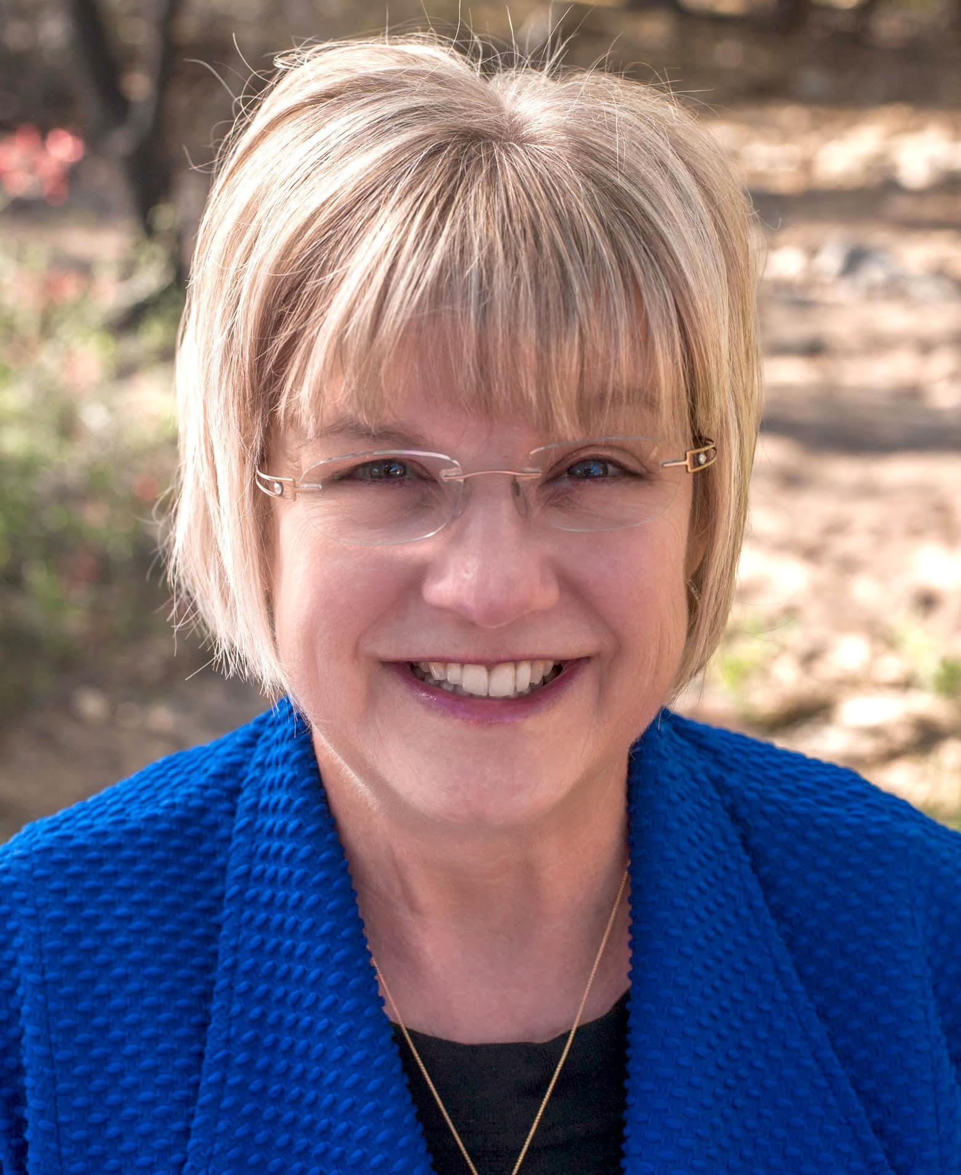
Leadership Skills Training
I am a Leader...Now What?!
Sindy Ready, PMN
Notes:
At WCR we all are at some stage of a leadership track and we all bring different approaches to leadership
In this session we will focus on some styles and tools that emerging leaders must adapt to be successful.
If you are an established leader, I hope that you will be inspired to use this information to mentor emerging leaders within your sphere of influence and most importantly let your leadership light shine bright, giving others permission to do the same.

Slide 2
Priorities for Today
Leadership Styles
Success Planning
Thinking Styles
Managing Conflict
Future Transition Plan
Notes:
The goal is to have you leave this session better prepared to lead or to improve your Leadership skills by:
Understanding your own leadership style and knowing how to capitalize on that style. Success Planning,
Recognizing ways to manage conflict and Having a Fututre Transition plan.

Slide 3
What makes a
GREAT Leader?
Notes:
Think about leaders you have really enjoyed serving with? What were some of the traits they had that you really liked. Write down a few traits. This can be within WCR or in your professional or Personal lives. Was it someone who really motivated you? Someone who helps you succeed in your goals Or maybe encouraged you to step out of your comfort zone!

Slide 4
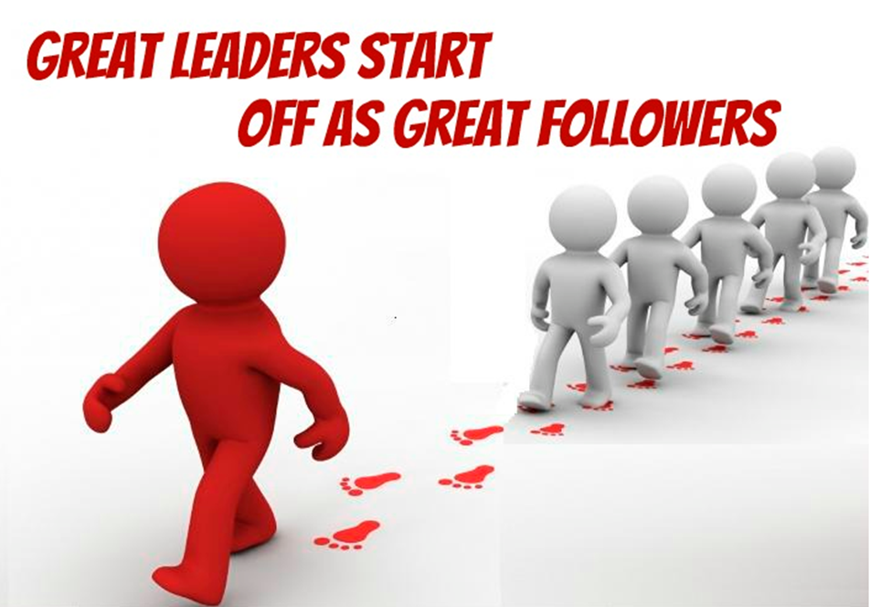
Notes:
In Women’s Council we Grow Great Leaders. And we all started off as a member and then were asked to volunteer in some manner. We go from attending meetings to helping out in some way and then moving into leadership. Then once we have served in a leadership role, we go back to being a great and supportive follower. Thank you for stepping into your leadership role!

Slide 5
LEADERSHIP STYLES
Autocratic
Participative
Delegative
Notes:
There are 3 popular Leadership styles: Autocratic, Participative, and Delegative.. ( Developed by Kurt Lewin, A psychlogist of of founders odf Social psychology. As I review each, assess yourself to see which one most represents your style.
You have identified your leadership style
How can you use this to your advantage to be successful Leader?
Given what you now know about yourself
Make a list of 5 things you would add to what you are currently doing and a list of 5 things you would stop doing to ensure that you are a successful leader.
What is your action plan to reinforce your style

Slide 6
Autocratic
Style
Tasks are dictated
Little or no group input
Unilateral decisions by
the Leader
Notes:
Authoritarian
Leadership Style
Tasks are dictated
Little or no group input
Unilateral decisions by
the Leade

Slide 7
Participative
Style
Accepts input on
decisions
Motivated, creative &
engaged members
Leader retains final
decision
Notes:
The Participative Style encourages group members to get involved with the decision-making process. They feel engaged in the process and are more creative and motivated. Allowing group input from members with specialized knowledge and expertise also creates good synergy and better outcomes with decision-making. A leader with a Synergized group allows members of the group to bring their best self to any task. This style of leadership can also be referred to as Charismatic. Research shows that Charismatic Leaders improve performance by 20% .

Slide 8
Delegative Style
Also know as Laissez
Faire
More hands off approach
to leadership
Works best with people who are independent and require little supervision

Slide 9
What's Your Leadership Style?
Notes:
What is your Leadership style? In Women’s Council Leadership environment, you must also take into consideration that you are working with a volunteer work force or Team. Unlike in a business where people are hired and paid to work, we rely on amazing volunteers! Your team will be made up of many different personality types as well. Taking time up front to understand the personlalities of our team members is key to our success.

Slide 10
TOP 5 TRAITS
ALL
Leaders Should Possess
Notes:
There are many different definitions of Leadership : Your job is to: Connecting the present to the future.
You’ve heard many Fortune 500 company Leaders say their roles are: “Recognizing the future” –Finding the future- Securing the future-
All of those are essential roles of Leaders.
The people we lead concentrate on the present tasks to accomplish the goals. The leaders primary responsibility is to take care of tomorrow by preparing for the future.
To do this effectively there are some essential characteristics that the Leader must have. Foremost and most importantly is Understanding your leadership style.

Slide 11
TRAITS
1) INTEGRITY
2) COMMITMENT
3) FAIRNESS
4) LISTENING
5) FLEXIBILITY

Slide 12
Success Planning
Success Planning
Present a clear vision
Set overall team goals
Team member assignments & expectations
Team member commitments to their role
Facilitate, support & monitor not micromanage
Congratulate and celebrate success individually
and for the team through out the year
Notes:
Great leaders help their team meet goals by presenting a clear vision, passion for the organization and the future! To be an effective leader, it is important that the people following you know what the goals for the group are, agree on the goals to be accomplished and how they will accomplish those goals. It will be crucial in the beginning to determine each persons role and get a commitment from them that they know their role and can fulfill their role to reduce any possible conflict later on. Process: Who does what and when. (Don’t have the cart before the horse action) Your job as the leader is to be a facilitator and keep everyone on track with their roles as well as keeping the team focused on the goals. Your reviews should always remind the participants “this is what we agreed we wanted to accomplish”. This keeps everyone focused on the goal and deflects any negative attention and unproductive discussion on the way things are being done and by whom. When two or more people have to work together, conflict is likely to happen.

Slide 13
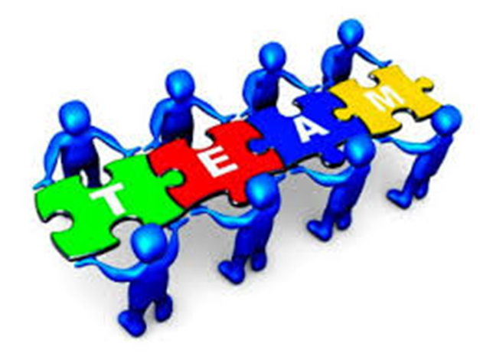
Board or Committee Meeting
Notes:
What we want it to be--Everyone is happy and one big team and everyone pulling equal weight

Slide 14
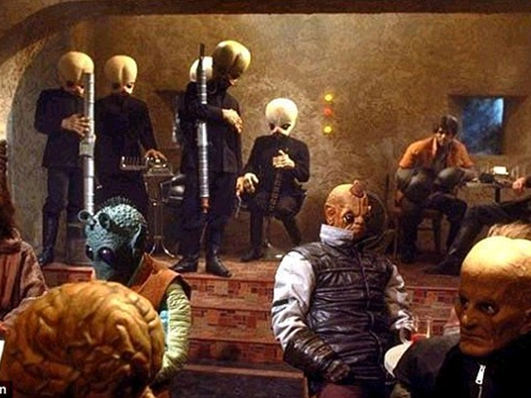
The Truth of the Situation
Notes:
Now visualize...we are all like a group of Aliens from the Star Wars movie. Underneath our smiles we do not know what is going on in our team members lives, their stress, etc.

Slide 15
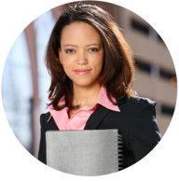
Understanding
Thinking Styles
Notes:
By now in Business or another leadership position, you have done some type of Personality profiles like the DISC profile or others. They are all great tools ! By looking at personality/thinking styles of the people we will be leading, we can be more effective in working within a group and resolving conflicts.Here is a one that is quick and easy to help you assess yourself and your team members. As I talk about each of the 4 types….assess yourself first.

Slide 16
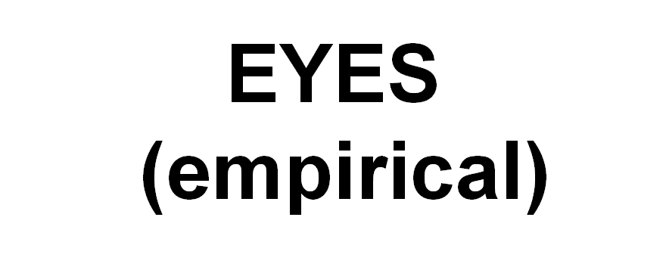
Notes:
Empirical Thinkers: Basically they want to see it to believe it. They want to observe to verify. Once they have verified or touched it...they are readty to make a decision.

Slide 17
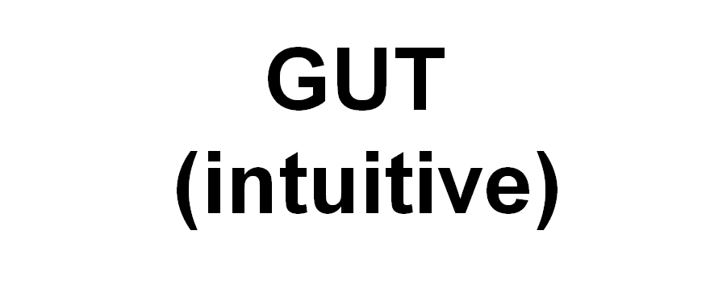
Notes:
Intuitive Thinkers: They go with their GUT! feeling (a sense) that doesn't use rational processes such as facts and data. Good intuition comes from years of knowledge and experience that allows you to understand how people and the world works.

Slide 18
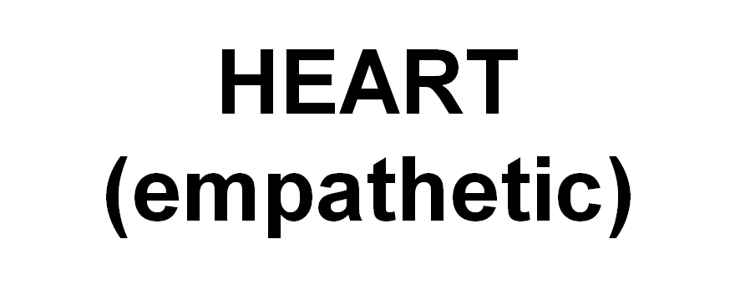
Notes:
Empathetic Thinkers: Very Caring! Want everyone to feel good about the decision. the ability to sense other people's emotions, coupled with the ability to imagine what someone else might be thinking or feeling.

Slide 19
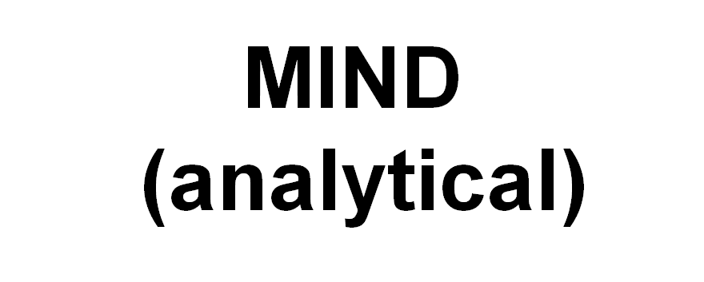
Notes:
Analytical Thinker: Wants to analyze all aspects of a situation before making a decision: It involves a methodical step-by-step approach to thinking that allows you to break down complex problems into single and manageable components.

Slide 20
Notes:
Now that you understand the different styles of thinking, can you see how in a group setting this can cause issues. Each thinking style adds important perspective to decision making….but somethings things acan be mis interpreted. Especially over text messages or conference calls etc. When the group can not see each other s faces and expressions or ask questions, feelings can get hurt. As a leader you much really focus on this. When you are asking the group to discuss and vote on important issues you must make sure that all siudes are heard and everyone is clear before a vote is taken.

Slide 21
Working with Different Styles
Notes:
•Sometimes the people we don’t get along with are more like ourselves.
•Some are frustrated by people who want to tell how they feel rather than dealing with the issue at hand.
•If people are abrupt, they are perceived as mad, when they are just getting to the point.

Slide 22
CIRCUMVENTING AND MANAGING CONFLICT
Notes:
Conflict is not always a bad thing. If it is addressed and resolved it can lead to positive changes and better decisions. If it is not resolved it can lead to low morale and possible failure. As Leader you must use your facilitation skills to help reach a solution

Slide 23
RESOLVING CONFLICT
Allow All Parties to Speak
Identify Areas of Agreement
Search for Solutions
Reach a Consensus

Slide 24
One on One Technique
Raising the B.A.R.
B: Breathe
A: Acknowledge
R: Respond
Notes:
On the phone or in person this technique is a great to help you react to a conflict.

Slide 25
Future Transition Plan
Not MY year or YOUR year - it’s the TEAM’s year.
All team members find & mentor their replacement.
All team members help and train their replacement.
Smooth and seamless transition between President and the President elect. You are a strong duo. Your team should see you as ONE!
Notes:
Not MY Year or YOUR YEAR- It is the TEAM’s Year
All team members find & mentor their replacement
All team members help and train their replacement
Smooth and seamless transition between President and the President elect. You are a strong duo. Your team should see you as ONE! This transition is so important and many times go south right after Leadership 360 when our newly trained President-elects come back from Leadership 360 all excited with great ideas and the current Presifnet feels that they are being pushed out too soon. As president if you sit down and review things one on one with your president -elect, you can share in their excitement and see what can be implemented now and what needs to be planned for to be in place next year. The industry is changing fast and we can react and make a stronger impact as 1 team moving from year to year.

Slide 26
The POWER of Leadership
Leadership is not just about what you do, but what you can inspire, encourage and empower others to do.
Jon Gordon

Slide 27
Leaders become great,
not because of their power,
but because of their ability
to empower others.
-John Maxwell

Slide 28
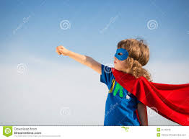
Be the Leader you would Follow!
THANK YOU!
Notes:
New photo.

