Slide 1


Slide 2
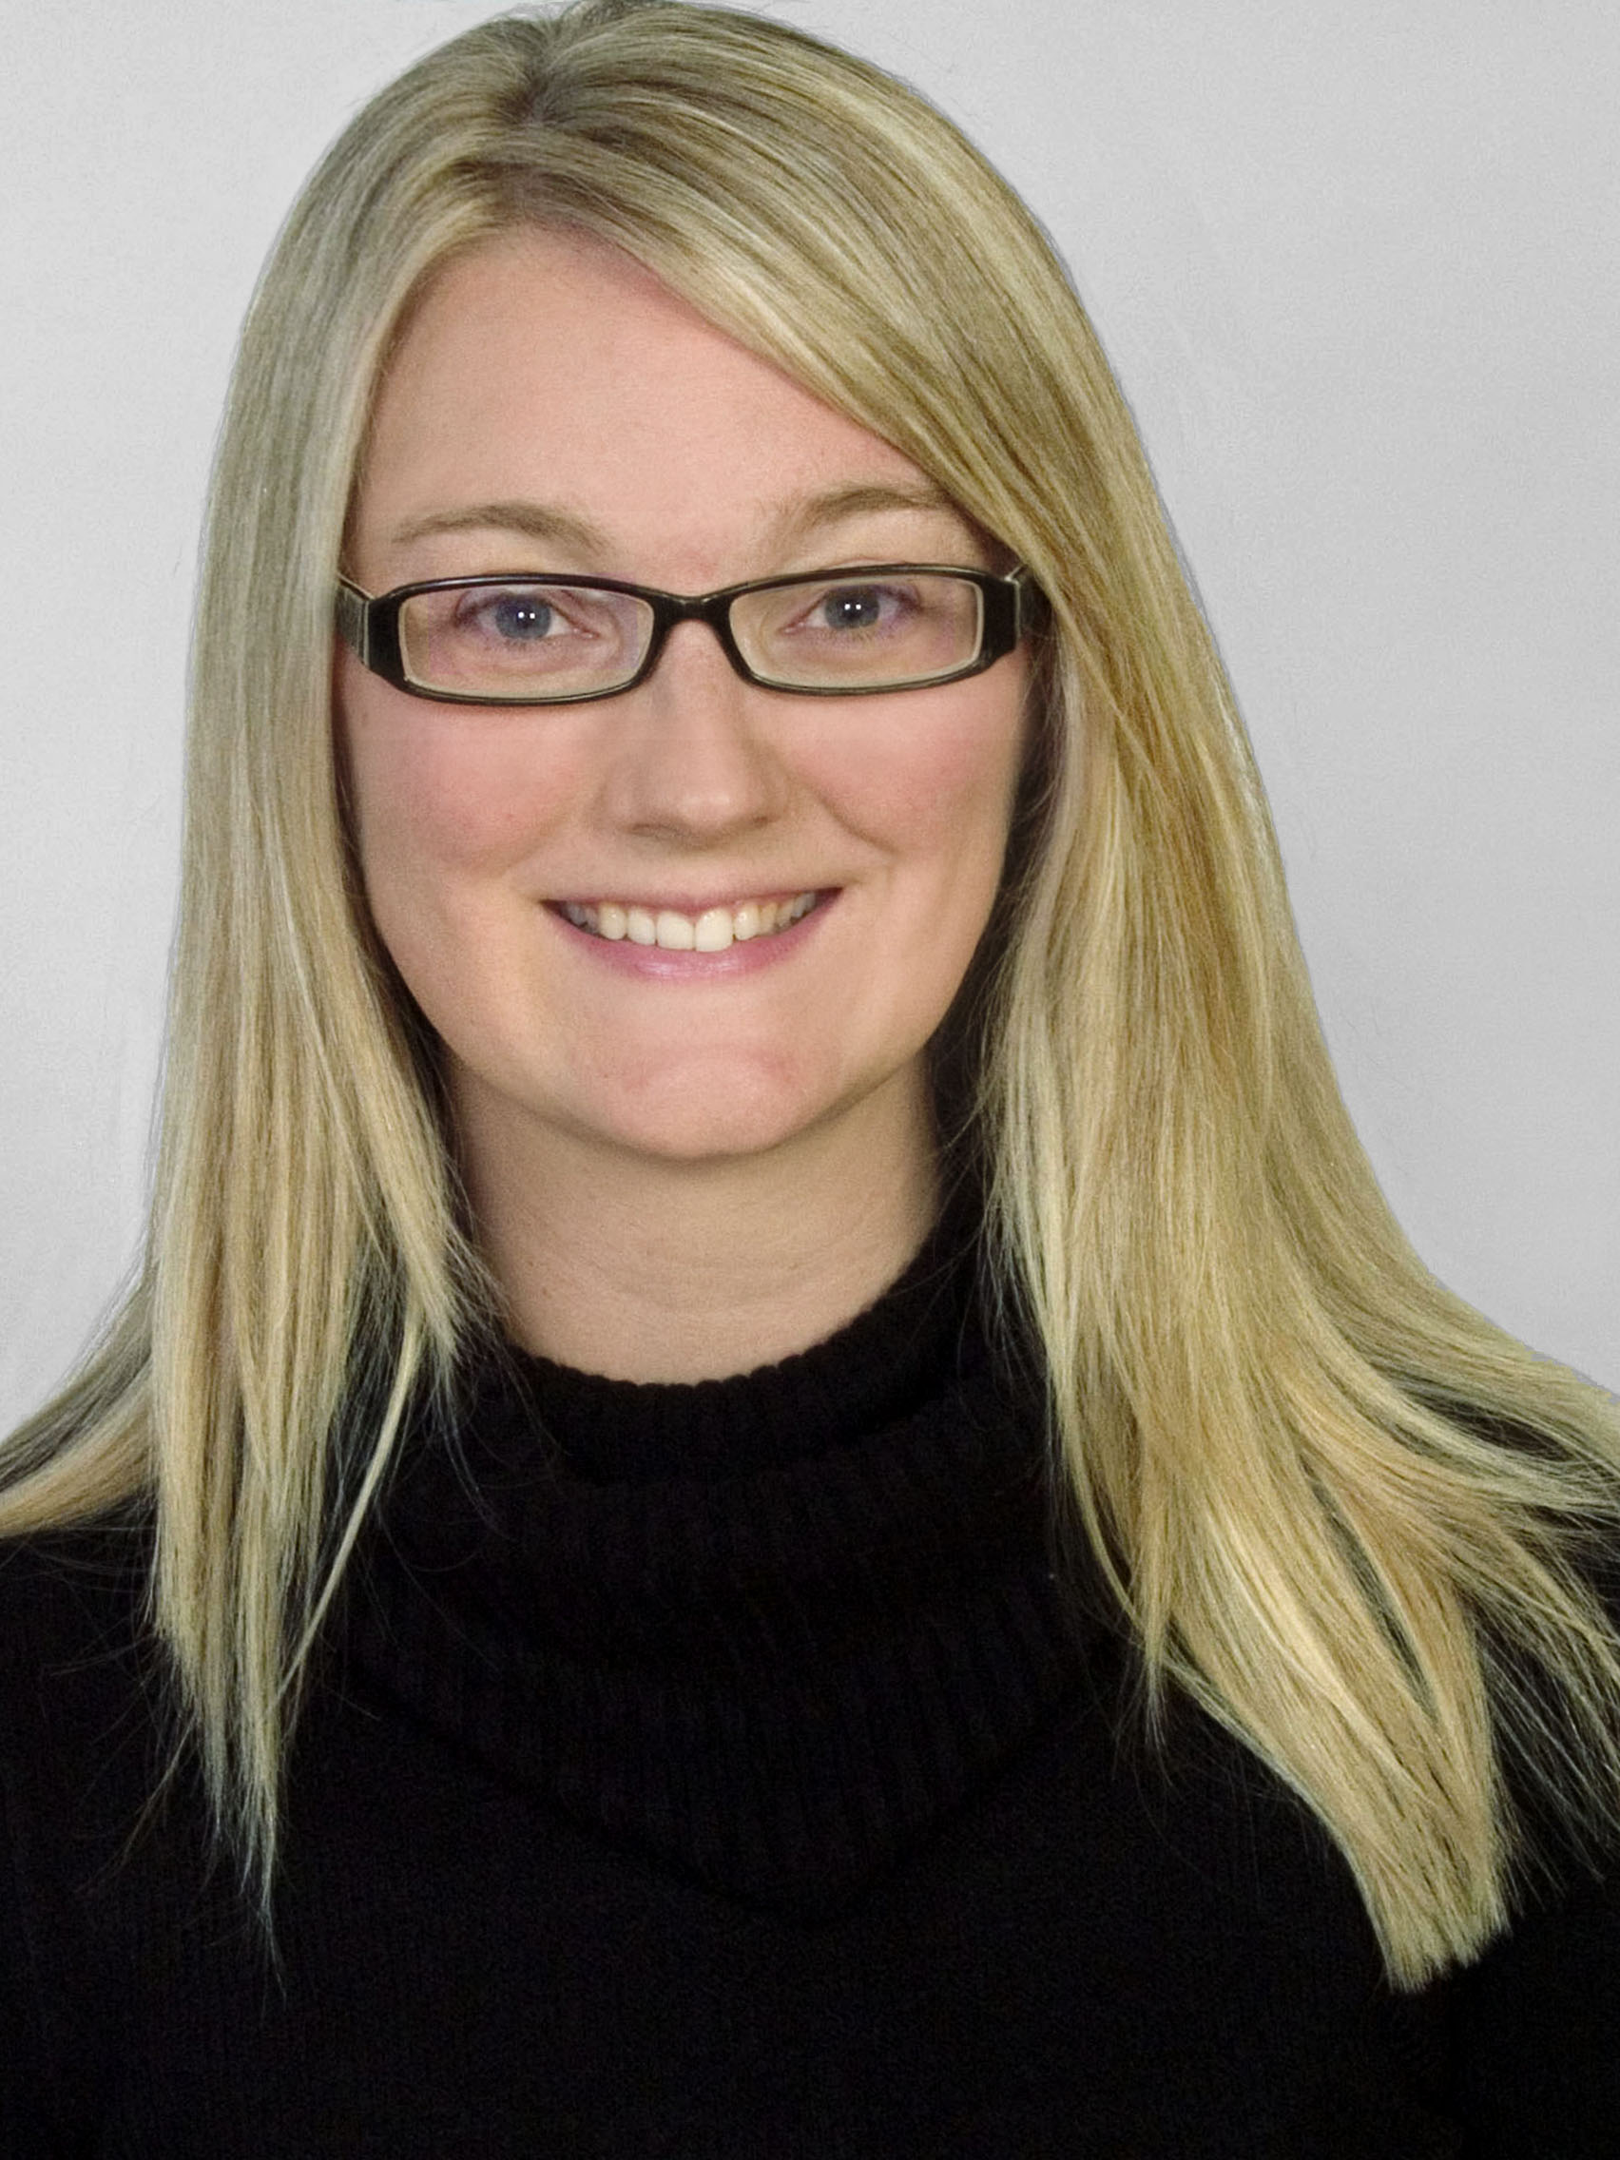
Exceeding Expectations: How to Wow Clients and Earn Referrals
Shay Hata, Realtor
Berkshire Hathaway KoenigRubloff
Chicago, IL
www.buyselllovechicago.com
shay@shayhata.com

Slide 3
Topics Covered
Setting yourself apart from other Realtors
Treat clients like gold
Concierge style service
Automating work flows and successful drip campaigns
Fun client appreciation events
Becoming the post-transaction resource
Have an extensive referral network
Connecting with your clients online and offline

Slide 4
Why?
77% of sellers did not use the agent who helped them buy the home. #1 complaint = lack of communication
I make money from your past clients since most agents forget clients after the transaction
Master the art of providing exceptional customer service throughout the transaction, executing relevant post transaction touch points and saying thank you because most of our business is gleaned from repeat clients
Being more efficient frees you up to have a life or get new clients

Slide 5
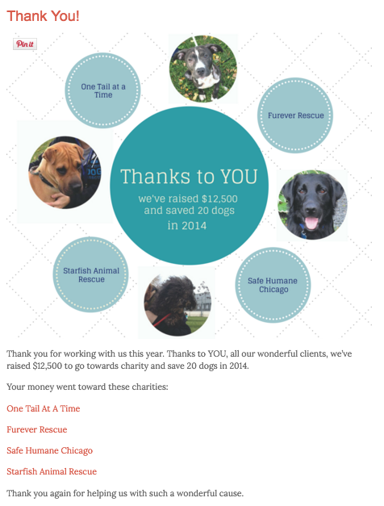
Be Authentic
What’s your why?
Be real
Attract clients like you
I donate money to animal
rescue groups and schools

Slide 6
How to Afford It
Stop spending money on shiny new objects
Stop buying technology – it’s not a magic bullet
Start spending money on past clients
Start partnering with vendors
Negotiate, negotiate, negotiate
Involve clients who own businesses
Stop buying leads, start earning them

Slide 7
How to Start – Have a GREAT Website
Create hyper local content
Explain the home buying process
Explain the selling process
Utilize a blog
Have a resource page
Give neighborhood perspective others can’t give
Use local photos
Write your own content
Use Google Forms

Slide 8
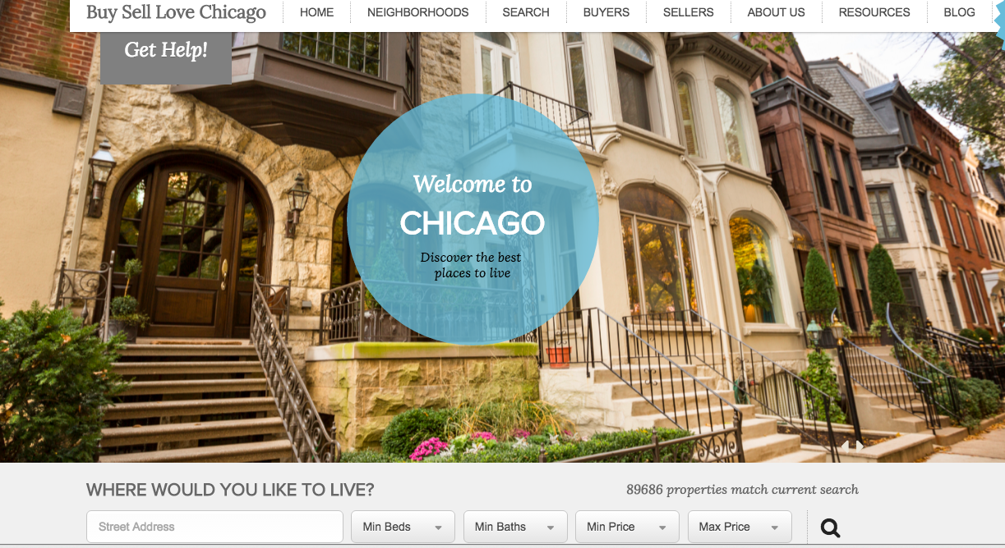
Placester.com – An NAR Member Benefit

Slide 9
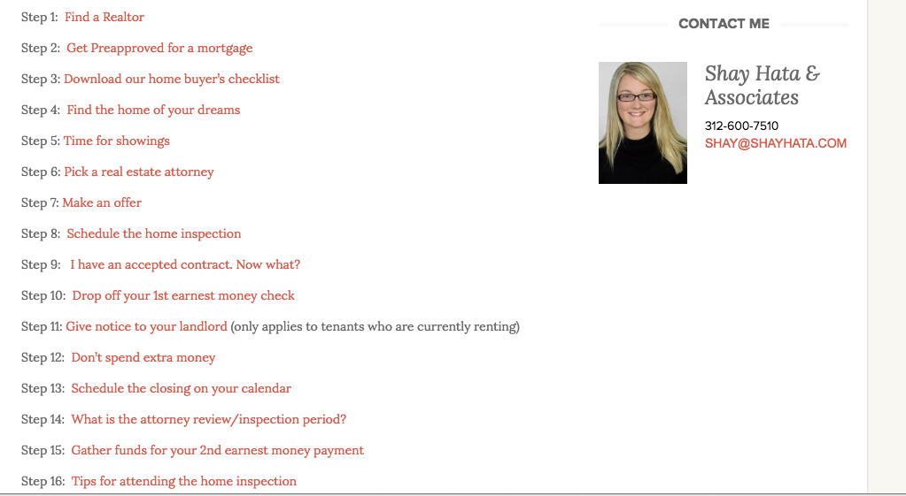

Slide 10
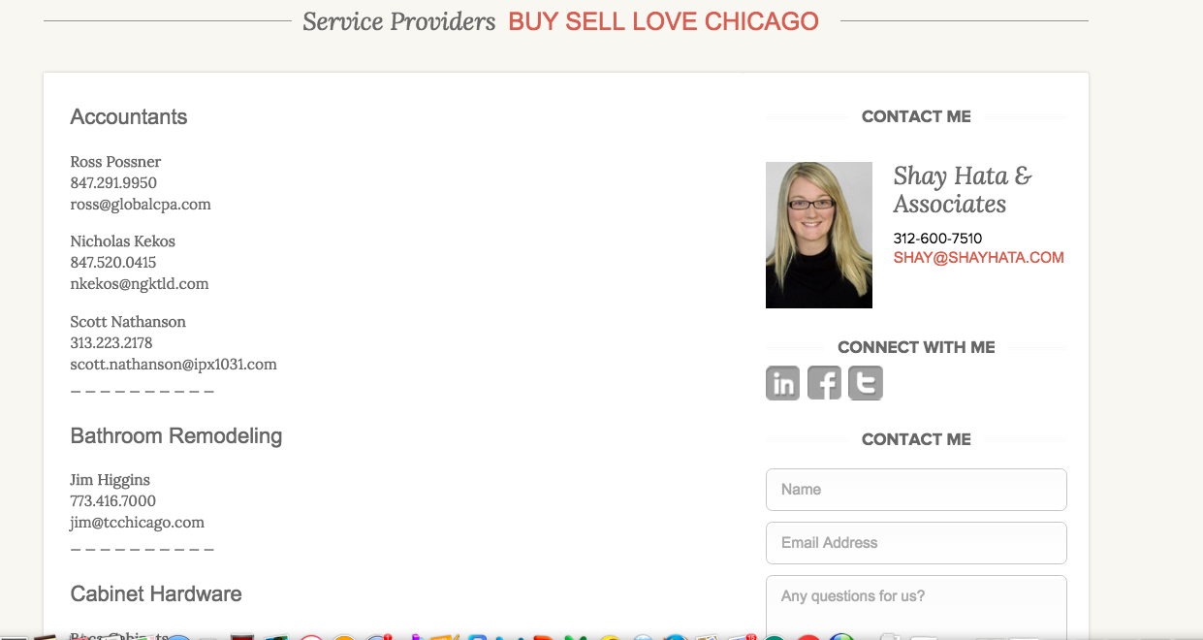

Slide 11
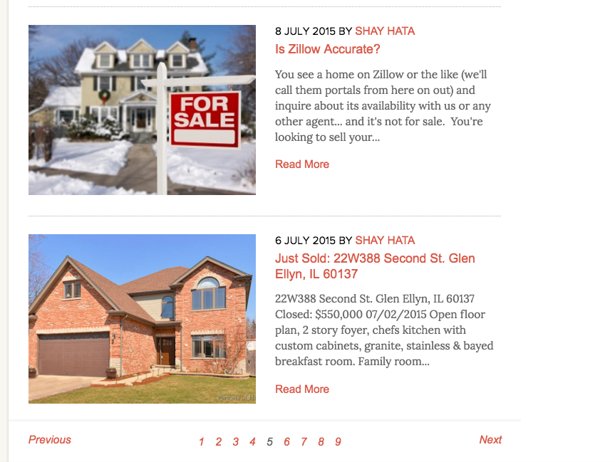
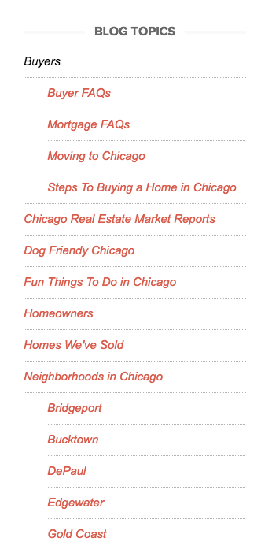
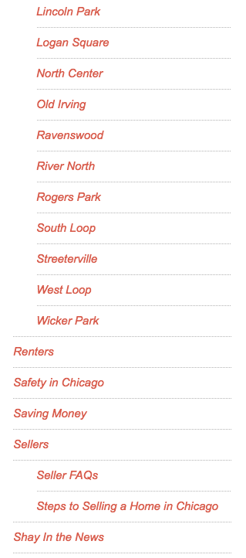

Slide 12
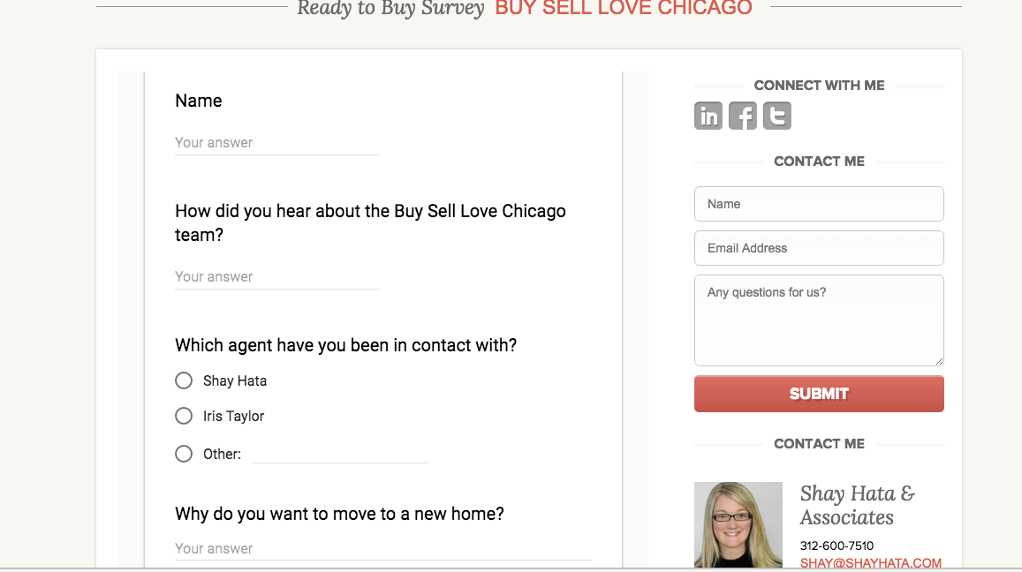
Use Google Forms To Save Time

Slide 13
2nd Step: Use a CRM
Must have a really good CRM
Segment by type of client:
A – Fans that need no reminders of you.
B – Clients that need a “nudge.”
C – Clients you never want to see again.
Convert B’s to A’s constantly.
Tag with likes and dislikes to sort later
Bucket clients with where they are in the transaction
Take detailed notes. Have addresses, anniversaries, birthdays, names of kids, etc.
Contactually (solo agents) /Realvolve (teams)

Slide 14
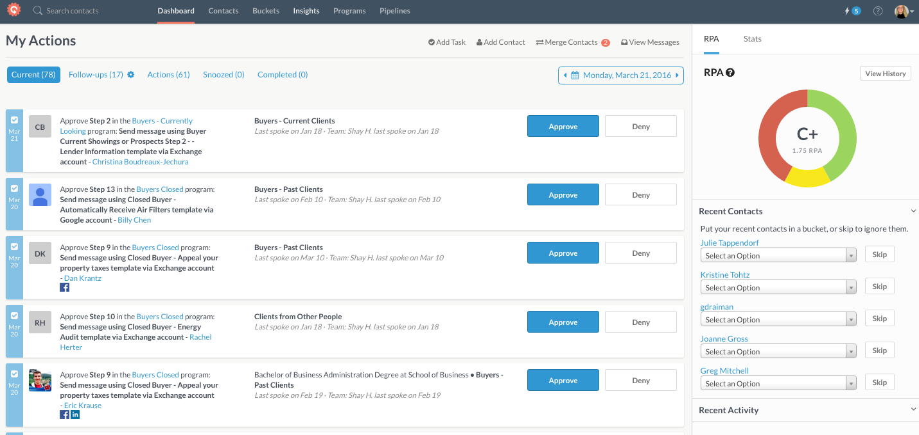

Slide 15
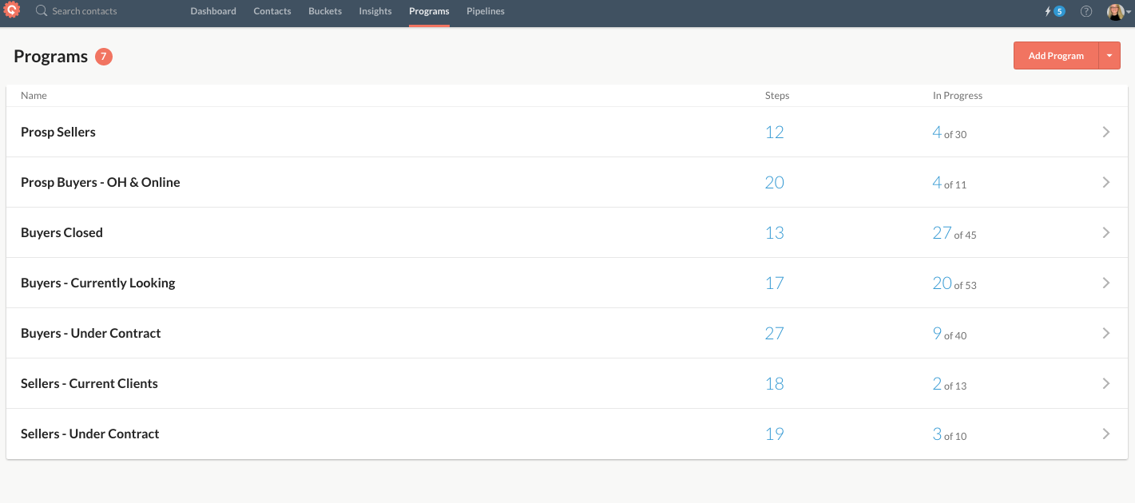

Slide 16
Automate Communication
Blog Posts
Anytime you find yourself answering a question more than once, make it a blog post
Prospective Clients (10 Things Not to Mess Up Your Loan, Safety Crime Maps, Free Money for Home Buyers, Are Zestimates Accurate, Protect Your Privacy Online, My Mobile App, Steps 1- 7 on my blog post)
Clients Under Contract (Steps 8-31 plus Meal for the Move, Pick a Closing Gift, Putting Your Home in a Trust)

Slide 17
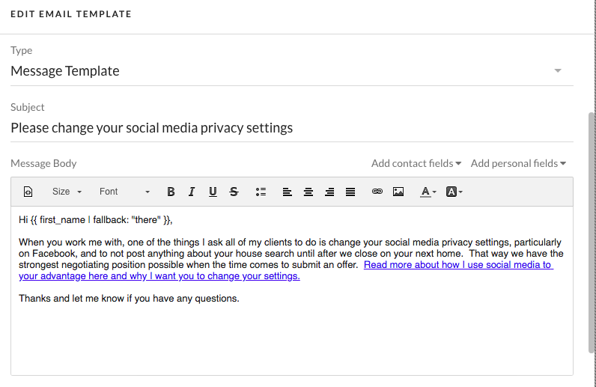
Automate Communication

Slide 18
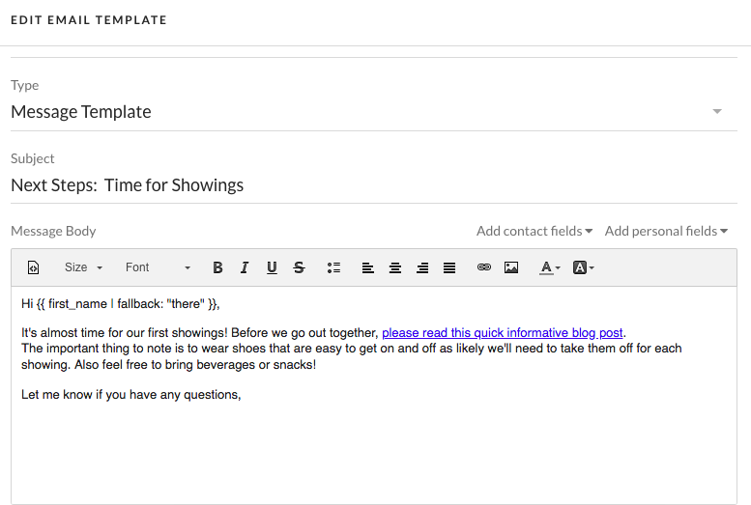
Automate Communication

Slide 19
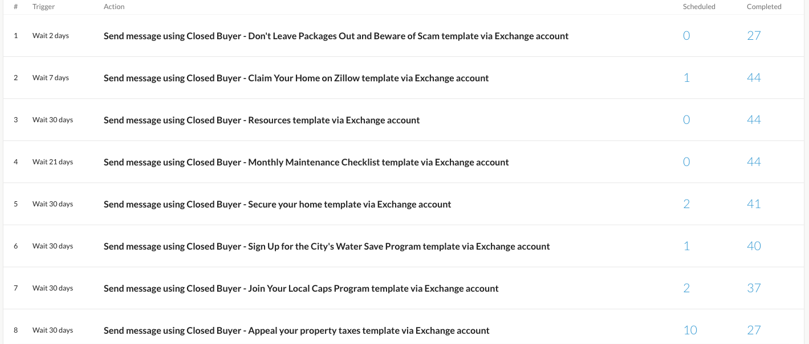

Slide 20
3rd Step - Organize Your Processes
Figure out each step of a transaction from start to finish and write it down – delegate if you have a team
Use a transaction management system – files, Excel, Insightly, Top Producer, Realvolve, etc.
Automate your tasks and communications
  What do you regularly have to communicate to clients?
  What tasks are the same for each transaction?
  Use Slack for teams or agents with an assistant

Slide 21
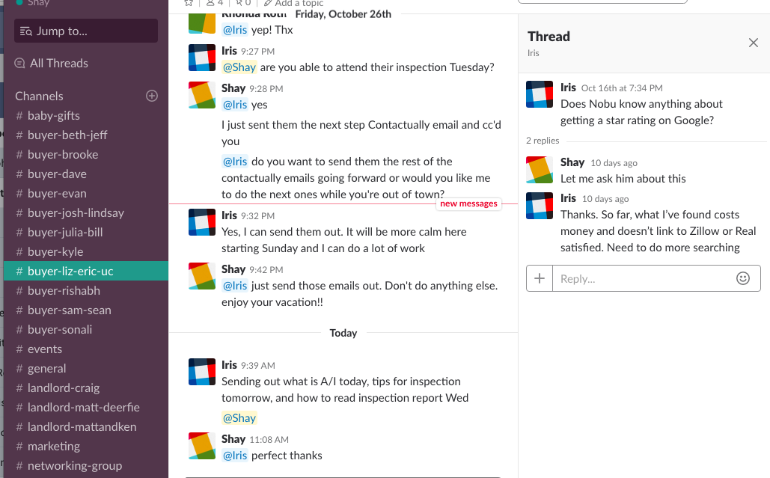
Communicate with Admins - Slack

Slide 22
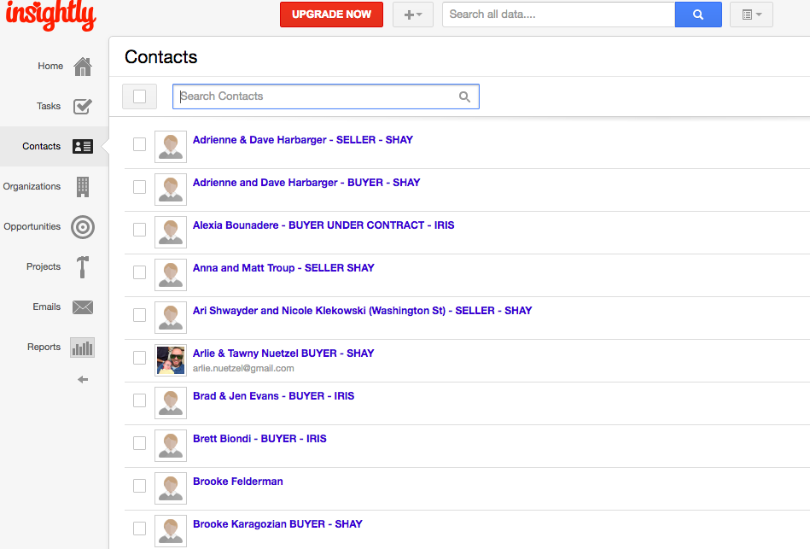
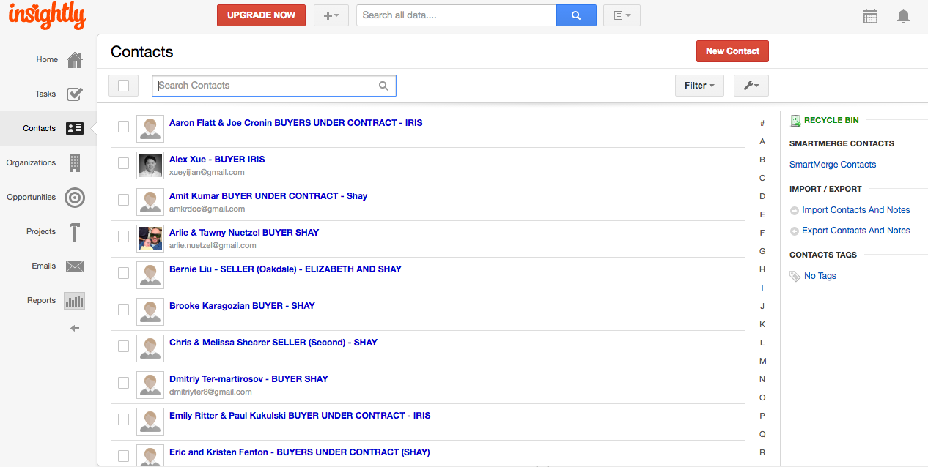
Transaction Management - Insightly

Slide 23
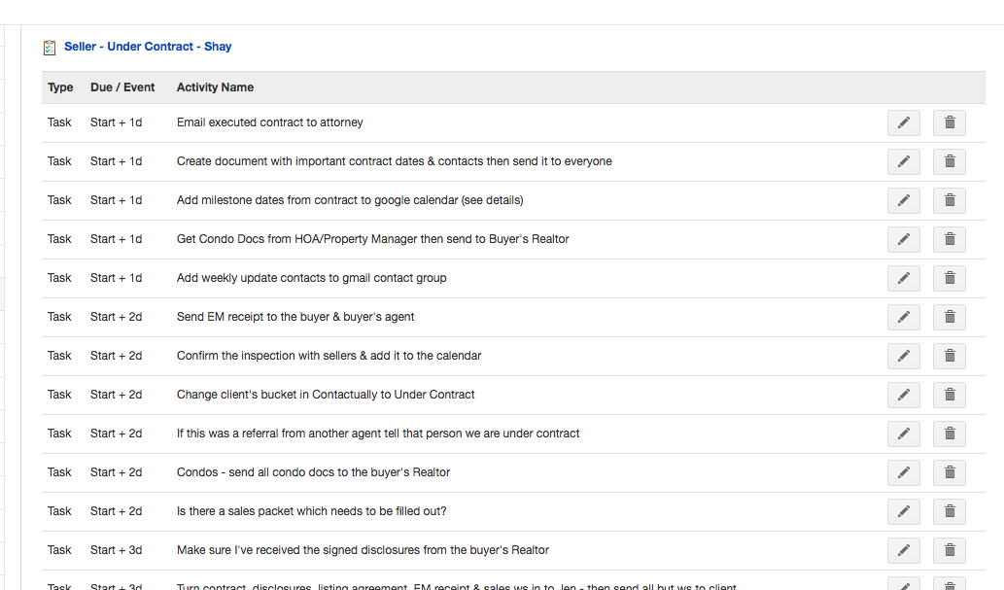
Insightly

Slide 24
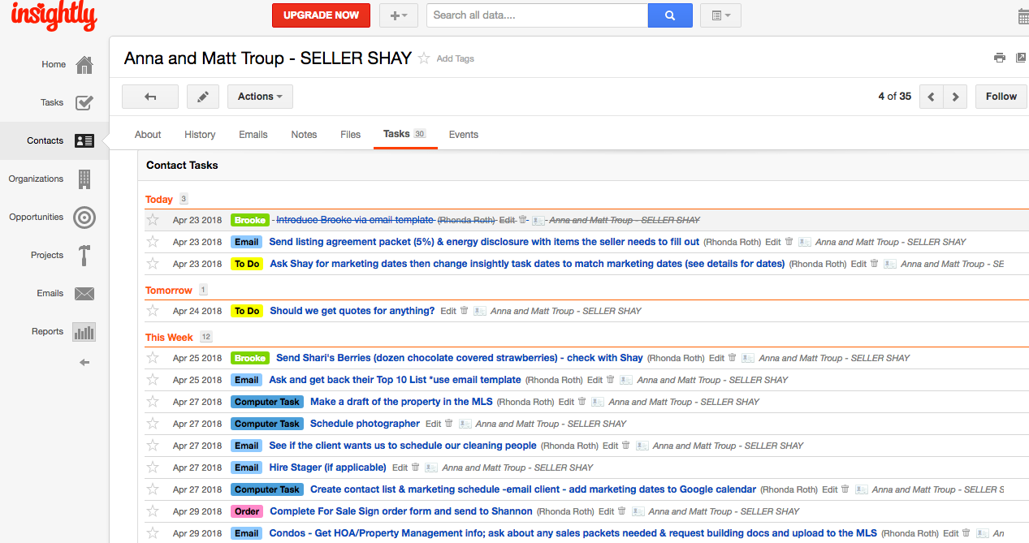
Insightly

Slide 25
How to Wow Your Clients
Concierge Style Service
All About You Form
Give them “busy work” books when
starting to work together and “homework”
Starbucks and snacks at showings
Clean car / a car that works for your market
Water and snacks always in your car
Kids packs in your car
Car seat for kids
Ask them for their referrals!

Slide 26
Treat Them Like Gold Once Under Contract
Google email account and voicemail for their property
Get estimates for them (renovations, moving)
Send moving boxes or Tiffany champagne flutes
Have resources for full service packing, unpacking, organizing, interior design
Closing gift of their choice (handyman, cleaner, gift card, photographer, house warming party)
Talk to them every day to ease their nerves
Meal for the Move (Google Form)
Updater.com
Lockbox on the property at final walk through

Slide 27
Make Their Lives Easier
Arrange a cleaning person/carpet cleaning for them
Champagne at closing – make it fun
After closing, home address stamp, just moved postcards and home owner book
Check in with them a week after moving in and then a month after that
Holiday ornament from Mpix.com
For VIP clients: Take out to dinner or host a house warming party.
Donation in their name

Slide 28
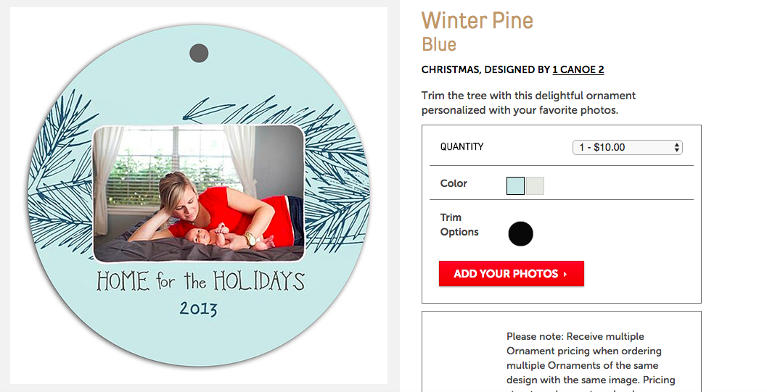

Slide 29




Slide 30
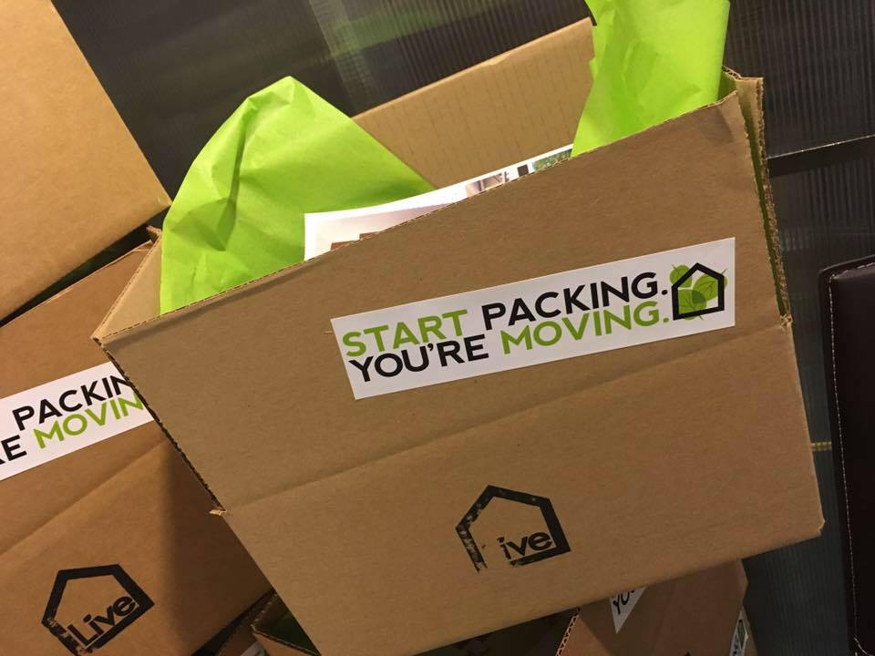


Slide 31
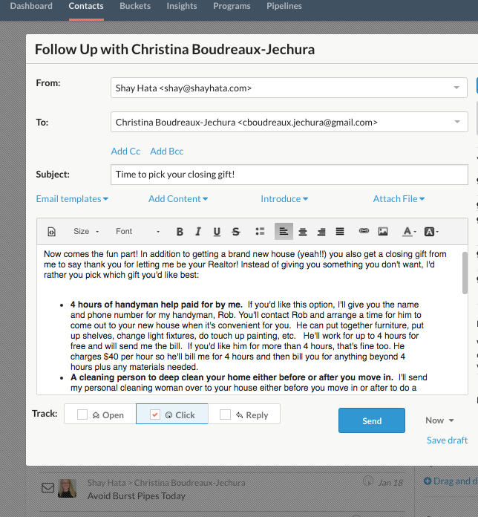

Slide 32
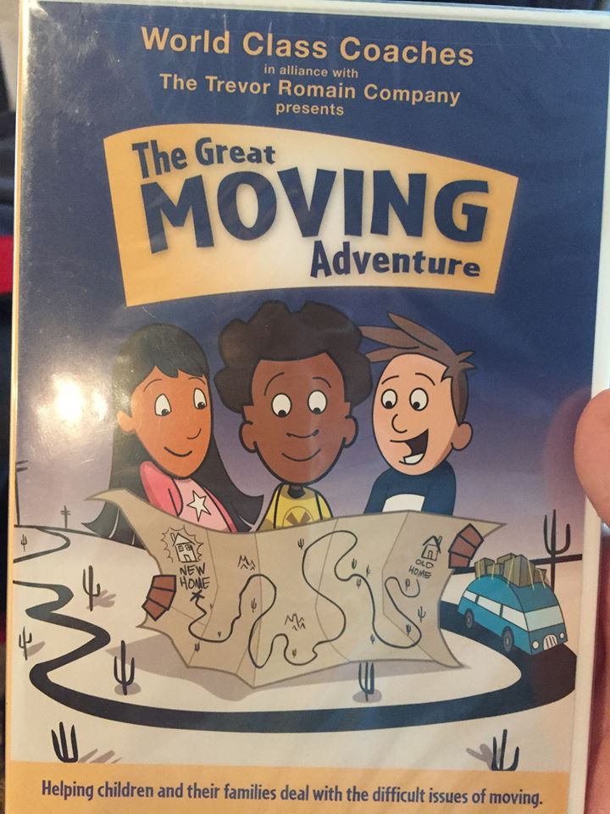
Don’t forget about the kids and pets!
Contract with the kids.
Books about moving
Kid activity packs.
Kid gift card.
Dog walker/daycare.

Slide 33
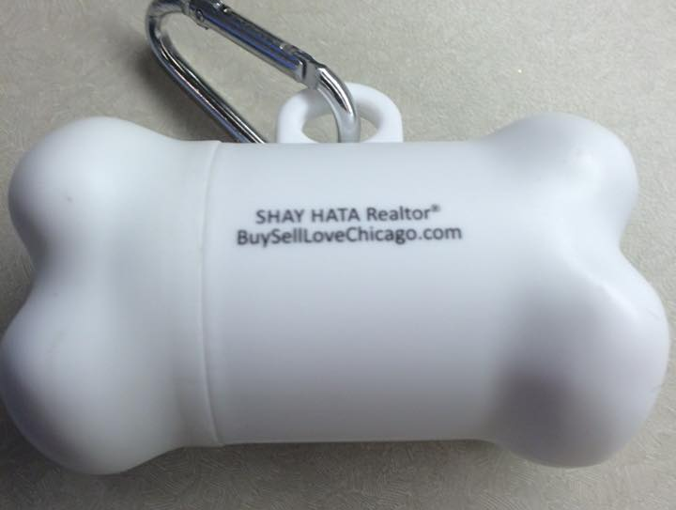
Treat Them Like Gold
AFTER the Transaction
After closing, home return address stamp/postcards.
Christmas ornament the first Christmas (mpix.com)
CMA at one year mark with a gift
Post transaction automated follow up for 5 years every month
Client events
Mailings
Charity Donation
Gifts for milestones
Reviews: Real Satisfied

Slide 34
Post Transaction Follow Up
Closed Clients (5 year follow up program every month) with hyper local content and targeted content for renters, buyers, sellers with ways to save them time or money such as:
Claim your home on Zillow
Maintenance reminders
Appeal your property tax reminders
Protect your pipes from freezing
Free money from city and state programs
Copy of ALTA statement in January

Slide 37
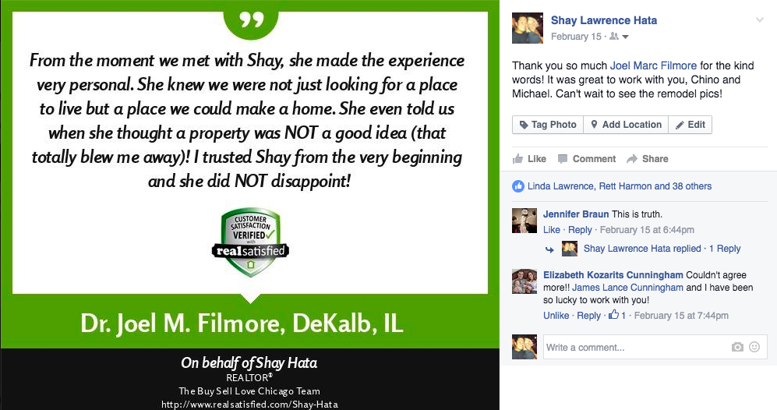

Slide 38
Mailings
Postcard with upcoming local events every other month
Starbucks gift cards in the fall
Lottery tickets in January
Cupcake coupons in the spring
Movie tickets in the summer
Ornament with a photo of their house
Just listed/sold all on one

Slide 40
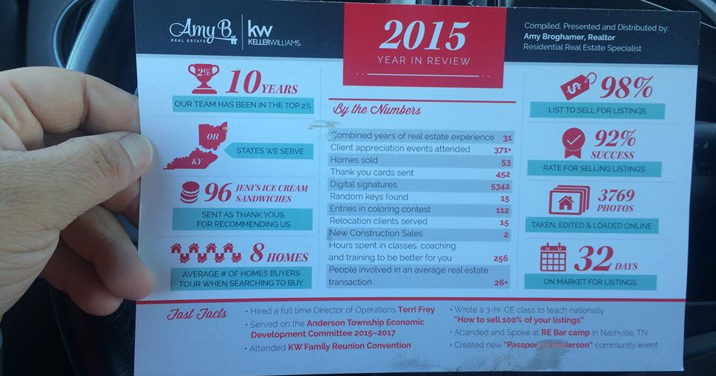

Slide 41
Client appreciation events
Rent a movie theater in the summer
Summer family BBQ
Thanksgiving pie pick up
Pumpkin patch event
Christmas Tree and Wreath pick up with Santa
Valentine’s Day Blow Out Party
Driving range outing
Give away sports and theater tickets
Hire a professional photographer for all events
Indoor kid friendly play event

Slide 42
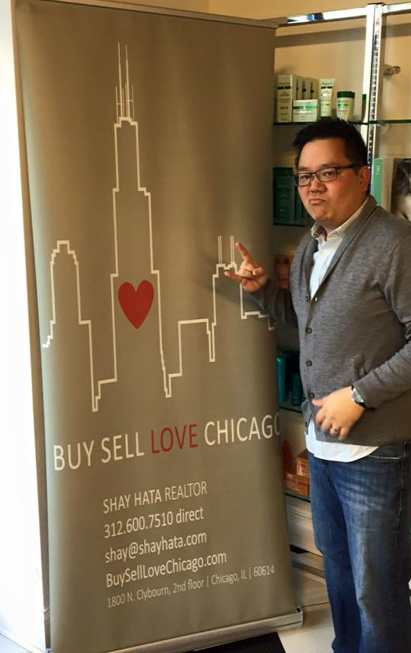
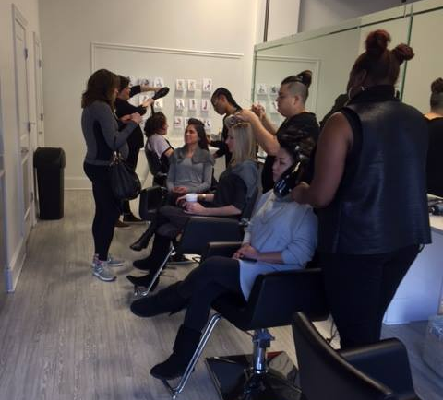

Slide 43
Be an online resource for offline needs
Have a good referral network
Put it on your website
Check in with them during heavy rains, weather events
Be a resource for friends moving to the area or other parts of the country (referrals)
Remind them about you via Adwerx

Slide 44

Adwerx
Client Sphere: 2500 impressions per month so no more than 500 people in each campaign. $79 per month
Listing campaign: $59 per week
Stay top of mind

Slide 45
Never forget
Stop buying leads, start earning them.
Be organized
Being memorable before and during the conversation makes it easy to be memorable afterwards to have post-transaction work flow.
Convert B to A clients
Post-transaction touch points are integral to repeat and referral business.

Slide 46
Thank you!
Shay Hata | BuySellLoveChicago.com
Berkshire Hathaway Homeservices
KoenigRubloff Realty Group | Chicago, Illinois
312-600-7510 shay@shayhata.com

