Slide 1
The Women’s Council of REALTORS® and You!
Get to know your Women’s Council and where it can take you.
Notes:
Good morning everyone, I am excited to be here today and talk to you about getting to know your Women’s Council of Realtors Membership and where it can take you. Thank you for taking time out of your day to be here with us. We are truly grateful for each and everyone of you.

Slide 2
OUR MISSION STATEMENT
We are a network of successful REALTORS®, advancing women as business leaders in the industry and the communities we serve.
Notes:
We are a network of successful REALTORS®, advancing women as business leaders in the industry and the communities we serve.

Slide 3
OUR VISION STATEMENT
The Women's Council of REALTORS® is recognized as the voice for women in real estate, and the premier source for the development of leaders in the industry, organized real estate and beyond.
Notes:
The Women's Council of REALTORS® is recognized as the voice for women in real estate, and the premier source for the development of leaders in the industry, organized real estate and beyond.

Slide 4
National & State Governance
NATIONAL
Heather Ozur – President
Brenda Lee Szlachta – President-Elect Pamela Banks – First Vice President
Sylva Siebold – Treasurer Chris Lee – Treasurer-Elect
Jeff Hornberger – Executive Vice President
STATE
Executive Team Andrew Bell – President Christine Citrano – President-Elect Amy Snook – Vice President Sandra Fernandez – Secretary Paige Brewer - Treasurer
Governors Charmaine Hickey Venus Proffer Dinorah Guerra District Vice Presidents Alma Bentacourt Denise Walker Gretchen Carlson Julia Montei Marie Gregorio Susan McQuillan
Notes:
I would now like to take a moment to introduce our 2019 Board of Directors.
In addition I would like to present our 2020 Board of Directors;

Slide 5
Local Governance
CURRENT GOVERNING BOARD Ivan Gould – President Anita Lambert – President-Elect Glo Reber – Secretary Alfredda Smith Herst – Treasurer Carolyn Hoff – Events Director Sheila Marvel – Membership Director
INCOMING GOVERNING BOARD
Anita Lambert – President Julianna Burns – President-Elect (TBD) – Secretary Alfredda Smith-Herst – TreasurerTina Gonzalez – Membership Director Dawn Merrill – Events Director
Under Governing Board Project Team Leaders Project Team Members Task Force Members
We are ALWAYS looking for Leaders!

Slide 6
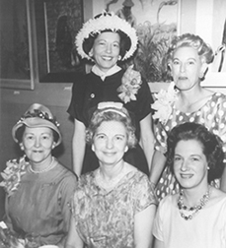
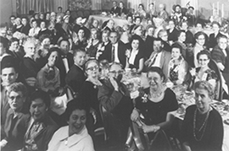
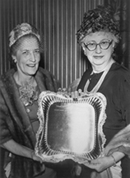
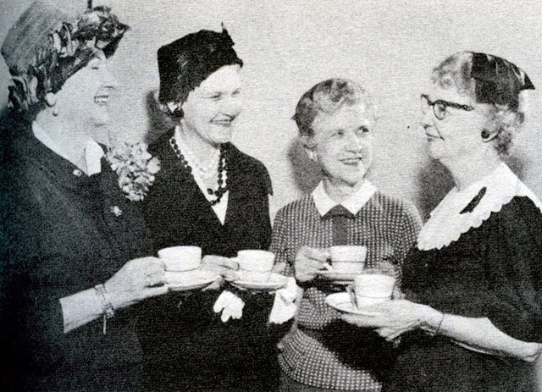
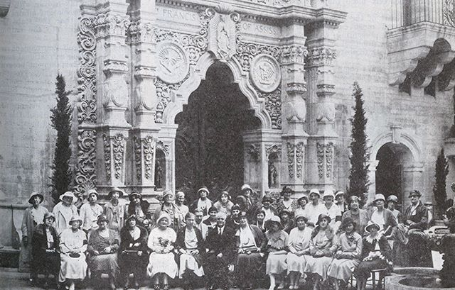
Our History and Heritage
Notes:
Most of what I want to talk about today is forward-looking. But to know where we’re going, it’s good to know where we’ve come from.
You belong to an organization steeped in heritage and history. (who can tell me what year WCR was founded?), that’s right! The Women’s Council was founded more than 80 years ago, in 1938 – only 30 years after NAR was founded. We are the oldest established affiliate of NAR in existence today.
In the late 1930s women had been drawn into real estate to fill gaps left by men drafted into military service. The industry was then dominated by men – including those affiliated with the National Association of Real Estate Boards – the former name of NAR.
The Women’s Council was founded, in part, because some local boards barred membership for women – even as late as 1950. Early women leaders in the industry began establishing local Councils around the US where women REALTORS® could network with colleagues, share leads, business tips and enjoy the camaraderie and support of a women’s business network.

Slide 7
Today’s Women’s Council
Notes:
The world has changed. Today, women represent the majority (62%) of NAR members.
Economic and social barriers for women in this industry have largely been erased, but the Women’s Council of REALTORS® remains a dynamic and evolving organization at all levels. Council events are designed to provide cutting edge education and networking programs to build your business leadership.
It is the pre-eminent business leadership affiliate of the NAR and the 12th largest women’s professional association in the US.
We have over 11,000 members in over 250 Networks. These groups organize some 1,500 events and programs every year. Our group has the strongest local network infrastructure of any NAR affiliate and most are closely aligned with the activities of local REALTOR® boards. In fact, WCR National are headquartered right inside the NAR building in Chicago and are a proud and loyal affiliate.
While branded as a women’s organization, men are welcome and comprise 10% of the membership. Many men serve in local and state leadership roles.
As our membership grows, the Council strives to broaden its base and appeal to members of other industry groups. We work to develop young business leaders and to evolve with today’s membership and business needs.

Slide 8
Building Business Leaders
Notes:
While the Women’s Council has come a long way from its origins, there is still a disproportionate number of business women in key leadership positions in both the private sector and association sector.
In the 110-year history of NAR’s national presidents, only seven (7) have been women. Top real estate firms have few key leadership posts filled by women.
In this context, the Women’s Council continues its altruistic goal of developing business leaders, with a strong emphasis on women.
Membership in the Women’s Council of REALTORS® is hands-on and experiential. This is a place where busy REALTORS® take on leadership roles and get practical experience and build skills in consensus building, running a meeting or an event, public speaking, teambuilding, and motivating colleagues.
We think we’re doing something right. While Council members represent only 1% of NAR’s total membership, we currently hold 23% of the NAR committee positions.
The information on the slide give you more insight into the role our members play in the industry. [Review key points on slide.]
Many Women’s Council members go on to assume local government positions and fill key corporate positions. And leadership in the Women’s Council is often a stepping stone into leadership roles within the larger REALTOR® organization. To give you an Example, our very own WCR state past president Sherry Meadows, is currently running for First Vice President of NAR.

Slide 9
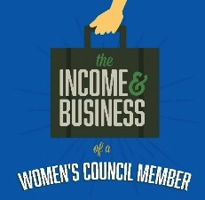
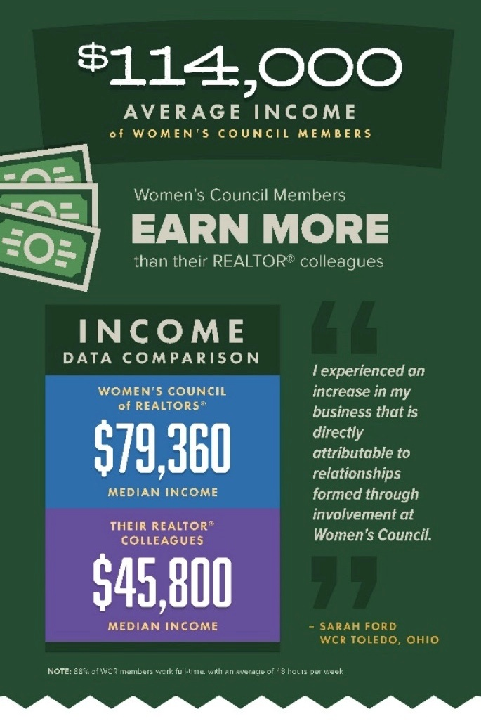
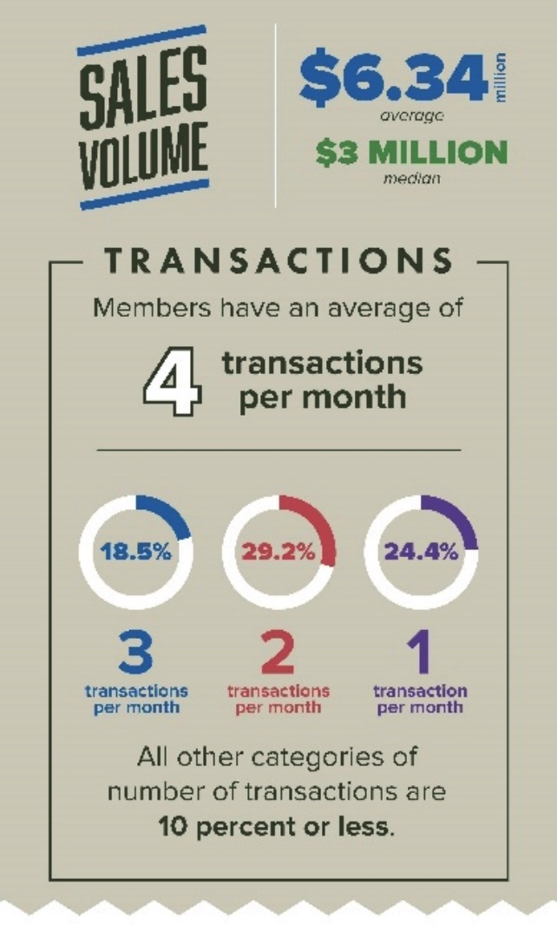
Average Income & Business
Income
Business
Notes:
Being a member of Women’s Council generates business – plain and simple.
Data from our Fall 2018 Member Survey proves this out. The average income of a Women’s Council member is $114,000.
To compare it to all residential REALTORS® we must look at the “median” income.*
Women’s Council members make more than $33,000 per year MORE than does the typical REALTOR®, defined by NAR.
We also know the average member has 4 transactions per month. While averages are affected by those with a very, very high number of transactions and those with no transactions, almost 30% of our members report earning income from two transactions per month.
*Note to presenter: The “Median” income is the point at which 50% of the total group make more and 50% makes less. NAR reports only median income so to compare we must use the median for Women’s Council members.

Slide 10
Referrals
Notes:
Half of our members’ business stems from referrals, including from clients, friends and other REALTORS®.
The Women’s Council is an important source of business referrals.
This referral activity means money in your pocket. On average, referral activity in 2018 resulted in $13,217 in paid commissions, per member, a strong return on investment for your dues!

Slide 11
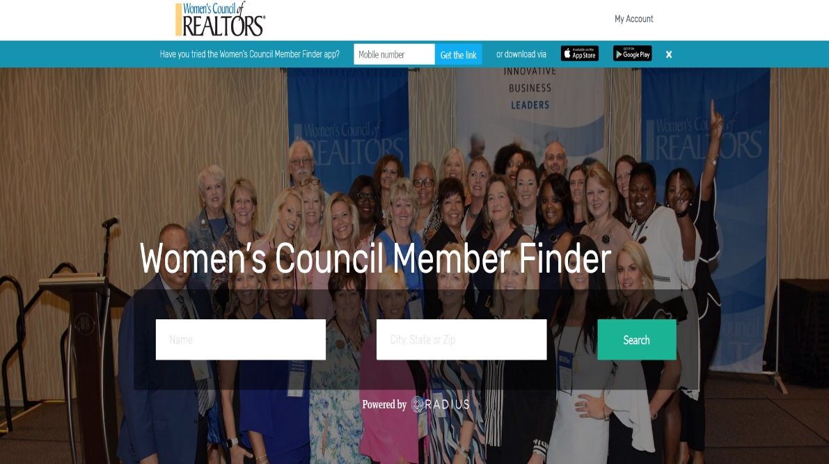
Referrals
Notes:
So, how can you put yourself in the middle of these transactions more?
Everyone in this room knows referrals come from different sources for different reasons. The easiest thing you can do to generate referrals is to make sure your information is up to date in the member expertise profile. The Council database is easy to find and easy to use – for both the public and other members.
Make sure your photo, bio, market areas, and other industry affiliations are up-to-date! We know that up to 25% of Women’s Council members have outdated information posted or have neglected to upload a profile photo. If they can’t find you…or can’t find out much about you…they aren’t likely to send you business.
Make yourself more visible to your Women’s Council colleagues, and the buying public!
Update from National on access, we were told on September 30th, all members will have access to your profile to get it up to date. Please keep your eyes open for an email from national. Also, when you were arriving today, we were asking you to verify your information. Please see Sheila Marvel after this presentation to make sure we have the most up to date information.

Slide 12
Member Benefits
www.wcr.org
Notes:
Members join the Women’s Council for different reasons. For some it’s the strong business network. For others, it’s the opportunity to develop leadership skills to use in their business, community or in the industry.
For me…. I joined WCR to….
The fact that members join for different reasons makes for a robust and diverse organization. The Council works to provide a broad range of benefits – something for everyone.
Many of our most valued benefits are right at your fingertips – delivered through our national website.
WCR.org is a treasure trove of information. Local Networks work seamlessly with the national website.
The Member Center at WCR.org is the home to numerous resources to help you grow your business. Here you’ll find more than 20 some recorded webinars—each a unique topic with nationally acclaimed speakers. Sign up for an upcoming live webinar or listen to recorded ones at your leisure.
Learn and get inspired with the leadership skills training modules and profiles of leading women in the industry.
The monthly eConnect newsletter brings you the latest and greatest information that you need to be successful in your business and career.
And, of course, you can access a database of Council members for referrals purposes through WCR.org.

Slide 13
Online Outlet Mall
https://wcr.savingcenter.net/
Notes:
So, we know about the camaraderie, the leadership, the great unparalleled network. But what about the ROI on your dues?
We have a Member Savings Center that we can access. You can find it at wcr.savingcenter.net, and we’ve put this together to provide more member value -- and to give you exclusive deep discounts that you can’t get from other groups that you belong to. So our discount program includes travel and entertainment, including discounts on movie tickets, shows in your local city, hotels, car rentals, and theme park discounts that you can use any time. The other category is business services, with discounts of 60% and up on providers such as FedEx and Office Depot. And other discounts in insurance, technology, identity protection and other tools for your business. Why are we doing this? Because we want to save members money and continue to show value to you as a member.
(visit savings center)

Slide 14
Social Media
Facebook
LinkedIn
Twitter
Pinterest
Instagram
Notes:
Now Connections are an important part of Council membership.
In addition to WCR.org, the Women’s Council has a dynamic social media presence – our largest on Facebook.
You can find “National Women’s Council of REALTORS®.” You will see they have more than 65,000 “likes”! That’s nearly 6 times the number of members!! Spend a few minutes at their FB page and you’ll see why.
Have you liked our Facebook? Do you follow? Lets all take a second to pull out our phones and check to make sure you follow local, state and national social media sites.
As you will see, we have one of the most dynamic and most engaging social media mediums in the entire NAR family. Business tips, motivational images and posts, great “Throw Back Thursday” pics and more give you the tools you need to get connected and stay connected.

Slide 15
Performance Management Network
1,000 elite designees
Focus on leadership and business skills
Earn in 2 – 3 days (credit for other REALTOR® designations)
Discounts & exclusive events for designees
PMN-only Facebook networking group
Notes:
Women’s Council has over 11,000 members but only an elite group of 1000 proudly hold the Performance Management Network designation, or PMN.
Where most other NAR affiliates grew up “around” a professional designation, the Women’s Council is unique. The PMN designation is not our reason for our existence. But we do offer a suite of courses for those wanting to further their education with the Women’s Council and obtain an industry designation.
The PMN designation can be earned in as little as 2 to 3 days of classes and maintained with an annual fee of $50, which is more than offset by discounts available to designees at WCR.org.
Courses focus on leadership and business skills. Live courses include Leadership Excellence, Networking and Referrals, Negotiation, and Harnessing the Power. A course focusing on the “business of your business” is offered online.
If you already hold one of NAR’s 7 certifications, you can obtain a course waiver for one class and you only need to take two.
In addition to coursework, the PMN application process requires proof of referrals and closed transactions, or a new leadership experience track, where you obtain points for your leadership involvement.
PMN designees are invited to exclusive networking events at national meetings. They also share a members-only PMN Facebook networking group where connections are made, and referrals are shared.
There are so many good reasons to pursue the PMN.

Slide 16
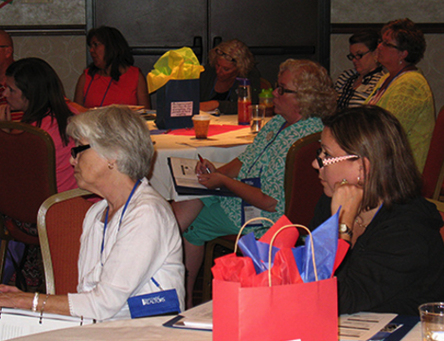
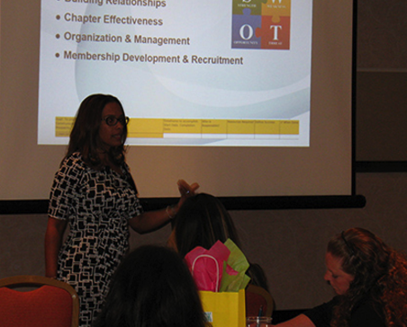
Leadership Identification and Development
What’s your talent?
Seeking grassroots talent for:
Leadership training courses
Board of Directors
Project Team Leaders
And more…
Notes:
By becoming involved at the local or state level, you know the dividends that service to the Women's Council provides -- the networking, camaraderie, professional development, and leadership development.
If you have the time, passion and desire, we'd hope you’ll consider getting involved at the local level with us. We just need to know who you are and about your talents. There are a wide range of opportunities. Let me share a few examples.
State holds a leadership academy for incoming State and Local Network Presidents every year during which time members with experience and talent teach the courses.
We have our 6 Board of Directors opportunities that members can apply for. President, President-Elect, Secretary, Treasurer, Secretary, Membership Director and Events Director
Then there our Project Team Leaders, Education & Industry Events, Marketing, Community Outreach, Finance & Budget, Membership and many more.
Perhaps you are an outstanding speaker or presenter and want to bring your talents to an event. Please fill out the membership questionnaire we have provided for you today. We want to know!
Our Leadership Identification and Development program is designed to identify talent at the grassroots level and match that talent with opportunities at a state & national level. There are timelines for appointment to certain posts, so if you’re thinking that next year would be a good time to get involved --- don’t wait to let us know!
Our goal is to provide you a path to get involved her with your local council that leads to state & national in a transparent way and help you develop your talents and abilities.

Slide 17
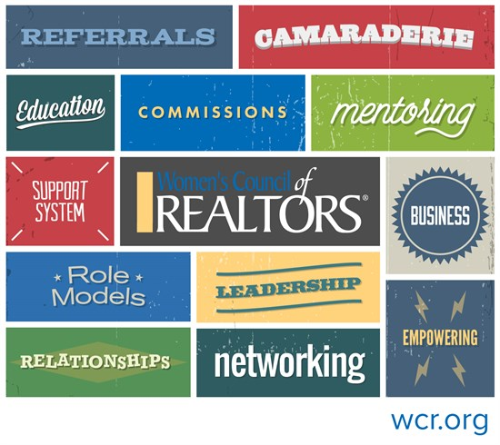
A Diverse Value Proposition
Notes:
In closing, I want to thank you for your membership in Women’s Council. You belong to an organization with over 80 years of history—and which is part of the culture, legacy, and history of the National Association of REALTORS®. The Council continues to evolve with changes in the industry and offer enhanced benefits. These benefits are wide-ranging. We offer something for everyone!
This organization has produced – and will continue to produce – business and industry leaders who play a critical role in organized real estate at the local and national levels, and in local governments, school boards, and other groups.
Thousands of commission dollars move through our referral network every month, with real and tangible business happening thanks to the connections made through the Council.
But many of our members tell us that what is most important is something far less tangible. It is the feeling of a support system, the camaraderie, and a sense of having a professional “home.”
I am so proud to be a part of the organization and I hope you are too. Thank you for your membership and thank you for coming today. If anyone has any questions, It would be my pleasure to answer them.

Slide 18
WHAT NOW?
GET INVOLVED
RENEW YOUR MEMBERSHIP
ATTEND INDUSTRY EVENTS
ATTEND STATE CONFERENCES
NETWORK
GIVE REFERRALS
MAKE THE MOST OUT OF YOUR MEMBERSHIP!

Slide 19
Thank you!

